Slide 1









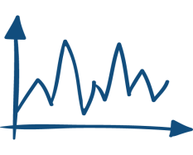
optimization
feedback control
robustness
learning control
model identification

Slide 2
Converged error
an optimal
compromise solution
Convergence speed

Slide 4

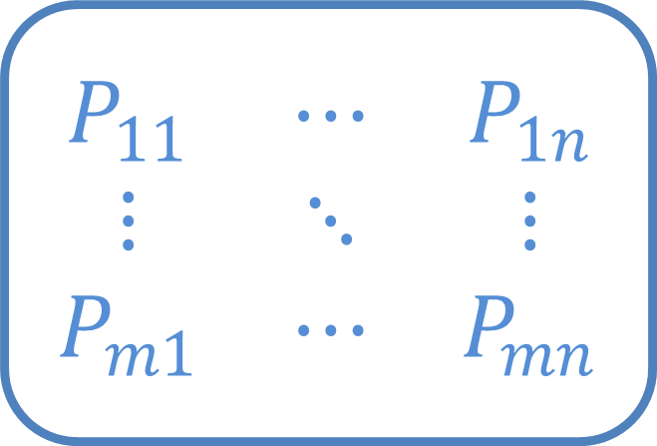

$$\begin{matrix}P_{11} & ⋯ & P_{1n} \\ ⋮ & ⋱ & ⋮ \\ P_{m1} & ⋯ & P_{mn}\end{matrix}$$
$$⋮$$
$$⋮$$
MIMO system

Slide 5
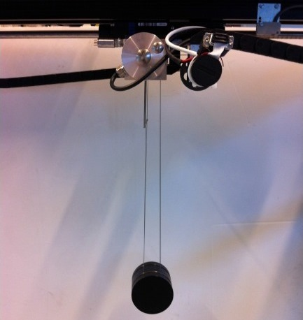

Slide 6
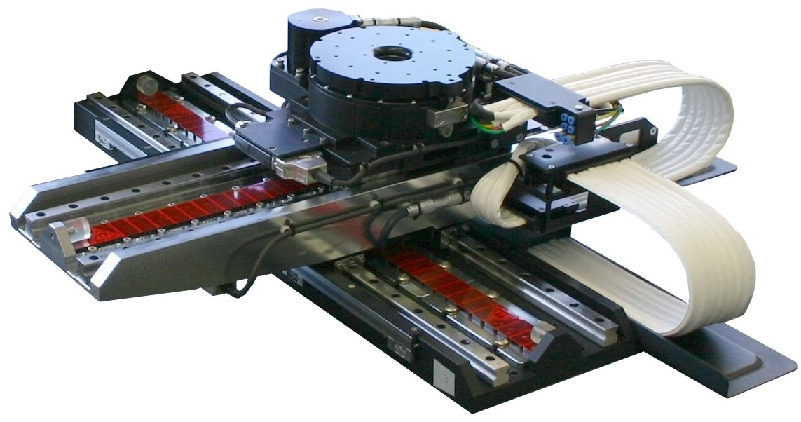

Slide 7
Iterative Learning Control
Iterative learning control (ILC) is widely used in control applications to improve performance of repetitive processes. Examples of ILC applications are: industrial robots (i.e. pick-and-place robots, gantry robots, cutting robots), motion systems (wafer stage, medical rehabilitation equipment…), batch processes (chemical processes, rapid thermal processing). The key idea of ILC is to update the control signal iteratively based on measured data from previous trials, such that the output converges to the given reference trajectory.

Slide 8
ILC system considers control task with finite time duration, leading to various ILC analyses and designs using the lifted system representation, i.e. learning matrices corresponds to the number of samples in the system. In this research, my main contributions are:
Proposed lifted system representation ILC robust convergence and robust performance analysis, taking into account model uncertainty
Proposed ILC design for fastest convergence and smallest converged error objectives

Slide 9
It is still a challenge to bring multivariable ILC to practical applications. The main reason is: most ILC algorithms in the literature rely on a two-step problem formulation (i.e. design learning function with the given Q-filter or vice versa) and the design procedures are usually heuristic. The parameter tuning steps are left to the designer. For example, a MIMO system (5x5) will require tuning for 50 functions, which is almost impossible.
In this research, an automated tuning design for MIMO ILC is proposed to solve all non-causal learning gains simultaneously:
Here, (2) is the robust convergence condition, where both structured and unstructured uncertainty can be considered. (3) is the tracking performance where $$ is the performance weight. (4) is the input constraint. In addition, the controller is formulated as both FIR and IIR filter type:

